Slide 1


Investigation of Wakes behind Blunt-Bodies during Re-Entry
Presentation by: Avery Stockdale-Stephens
Mentor: Dr. Kyle Hanquist
Computational Hypersonics and Nonequilibrium Laboratory
The University of Arizona
Notes:
1

Slide 2
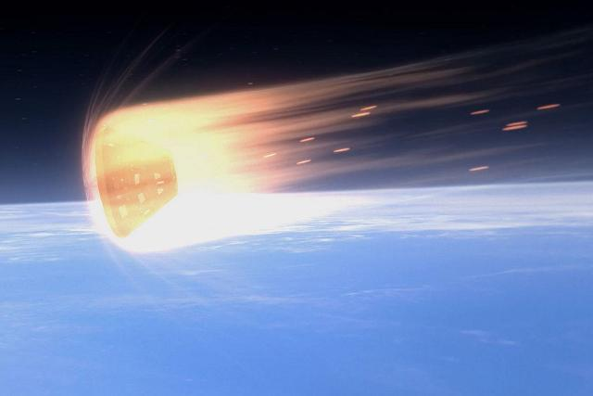
Introduction and Problem Statement
Re-entry vehicles face some of the most extreme conditions possible
Extreme speeds bring extreme temperatures and pressures and can cause molecules to split apart
The ability to model and simulate these kinds of vehicles through computational fluid dynamics (CFD) can have many benefits
Improved vehicle design
Visualize physics that apply to capsules during re-entry
Source: eandt.theiet.org
Notes:
12

Slide 3
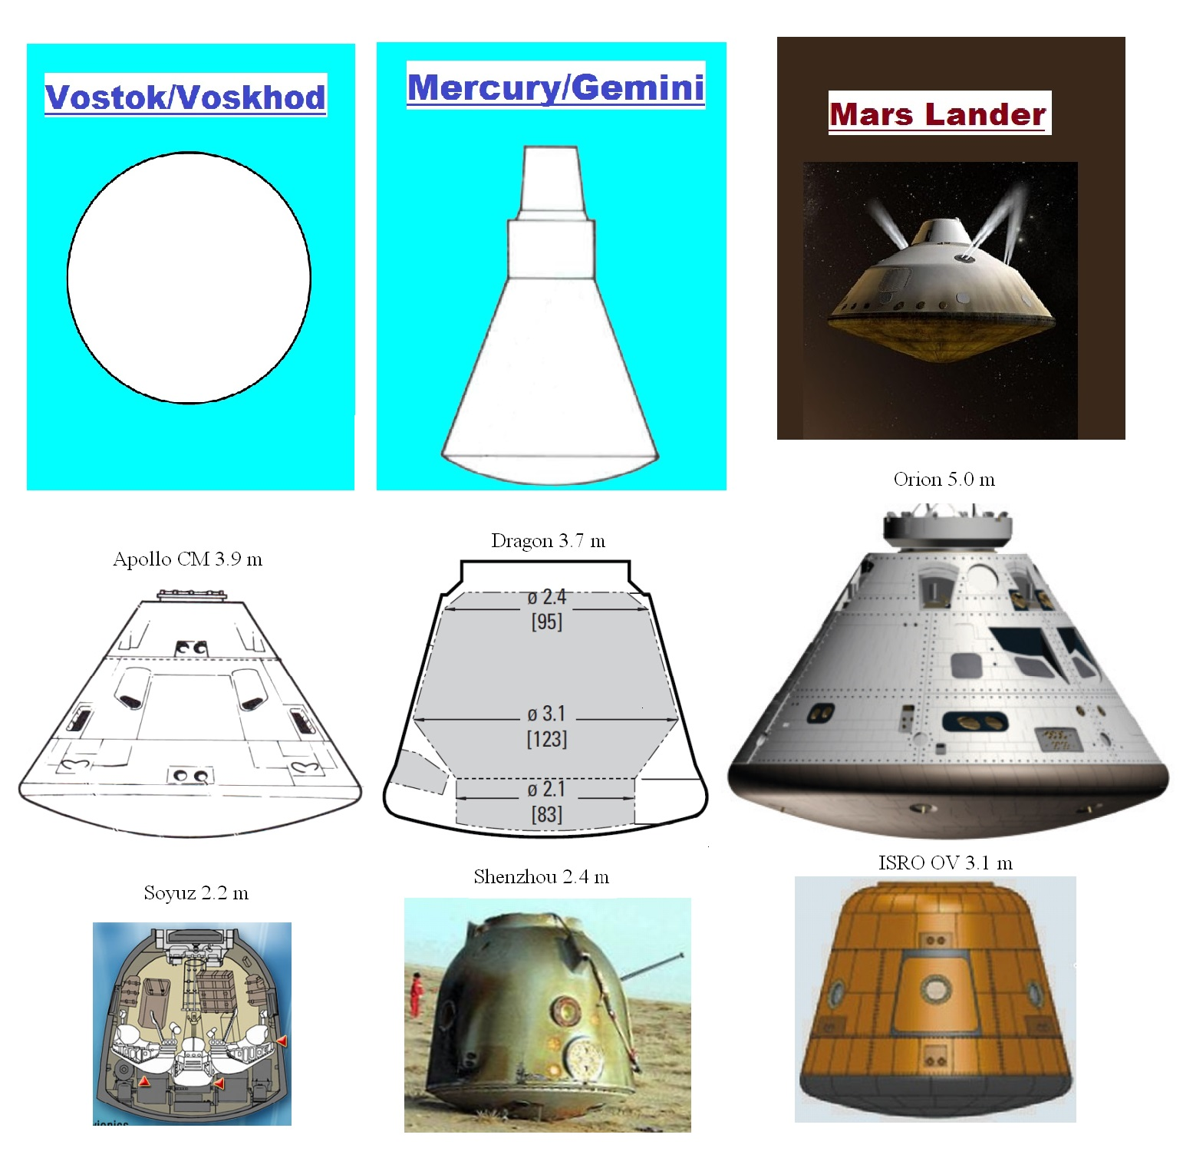
Why are Re-Entry Vehicles Blunt?
In simple terms – to slow down!
Vehicles must slow from ~12 km/s to 0 km/s without damaging the internal components or passengers
The more normal to a surface the shock is, the more the air is slowed going through the shock
Normal shocks are stronger than oblique shocks
Stronger shocks means more drag
Lots of drag is good for slowing down
Source: planetaryvision.blogspot.com
Notes:
12

Slide 4
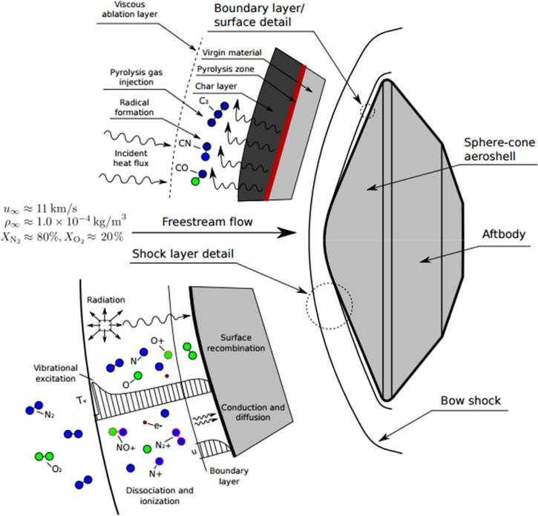
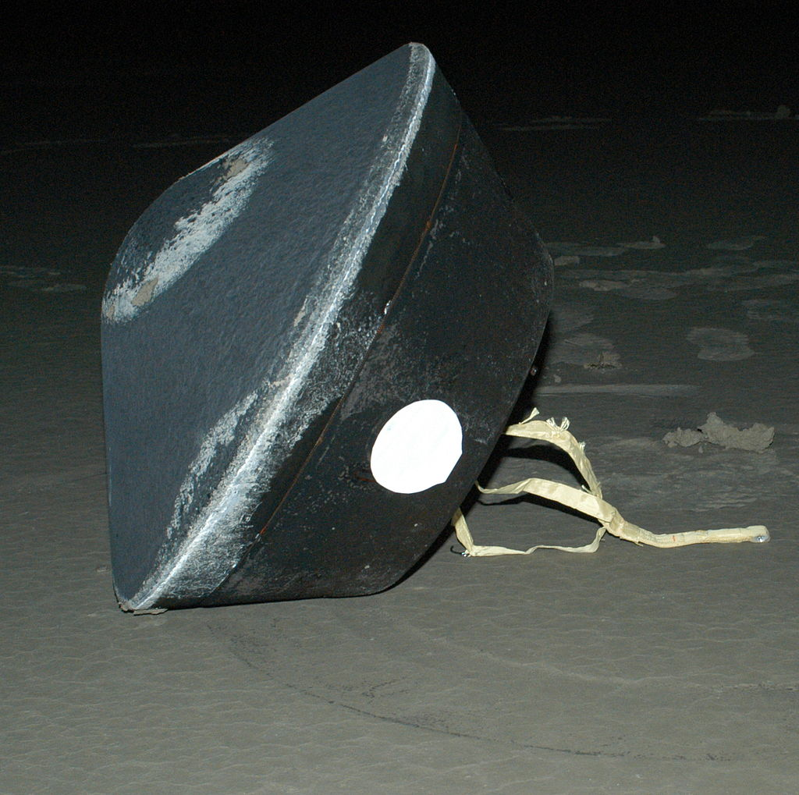
Objectives
The Stardust mission launched in 1999
Collected interstellar dust from comet Wild-2
The first sample return mission of its kind
Re-entry capsule for this mission was the fastest recorded man-made object in history
Mach numbers of up to 37 at sea level density
Capsule entered the atmosphere at 12.9 km/s
This research aims to model and simulate the re-entry of the Stardust capsule so the extreme aerodynamic effects can be studied and investigated
Source: Numerical Approach to Ablation Measurements using a New Plasma Pre-Heating Technique
Source: nasa.gov
Notes:
12

Slide 5
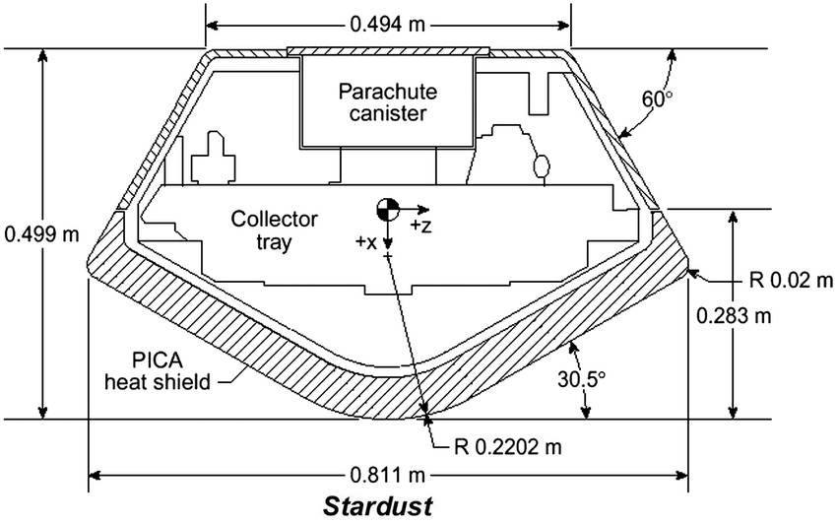


Methods
Start with the defined geometry of the Stardust capsule
Create a geometric mesh using open-source meshing software, gmsh
Import mesh into open-source CFD solver, Stanford University Unstructured (SU2)
Examine results and refine the mesh accordingly
Source: Modeling of Stardust Entry at High Altitude
Notes:
12

Slide 6
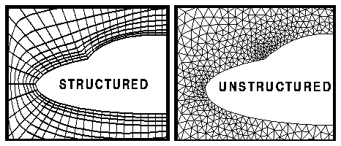
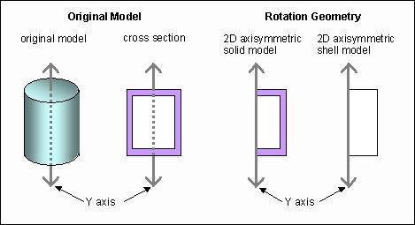
What is a Computational Mesh?
A computational mesh is a grid made up of small elements
A series of differential equations is solved at each element – Navier-Stokes equations in this case
Meshes can be fully structured, fully unstructured, or hybrid structured-unstructured
2D or 3D
Axisymmetric condition – define a line of symmetry and the CFD solver knows to mirror the mesh about the line
Source: nasa.gov
Source: support.ptc.com
Notes:
12

Slide 7
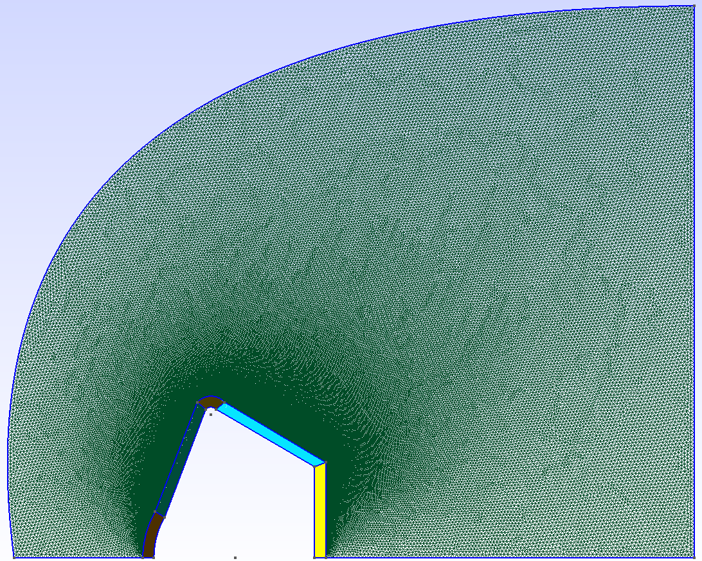
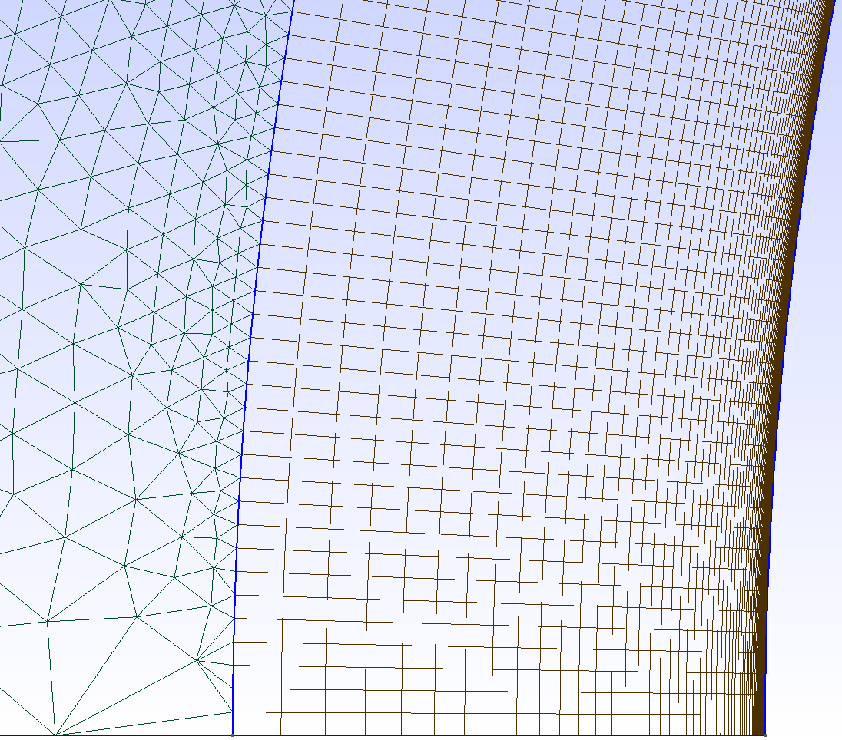
Results
Mesh
Image to the right shows the mesh
Image below shows detail of boundary layer region
Important features:
Line of symmetry
Hybrid structured-unstructured
Freestream shaped to fully capture shock structure
Notes:
12

Slide 8
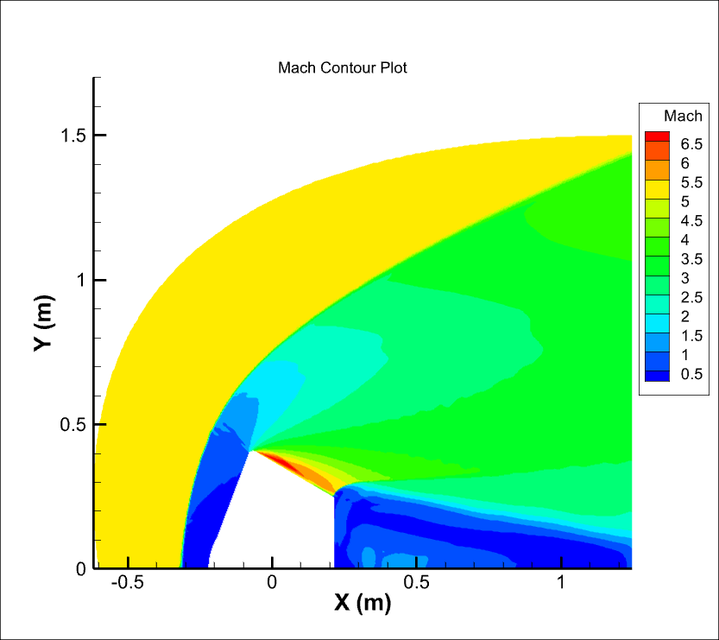
Results
Simulation
Capsule simulated with freestream conditions:
Mach number = 5.12
Angle of attack = 0
Temperature = 219.47 K
Pressure = 1.197E3 Pa
Standard air model (77% N2, 23% O2)
Notes:
12

Slide 9
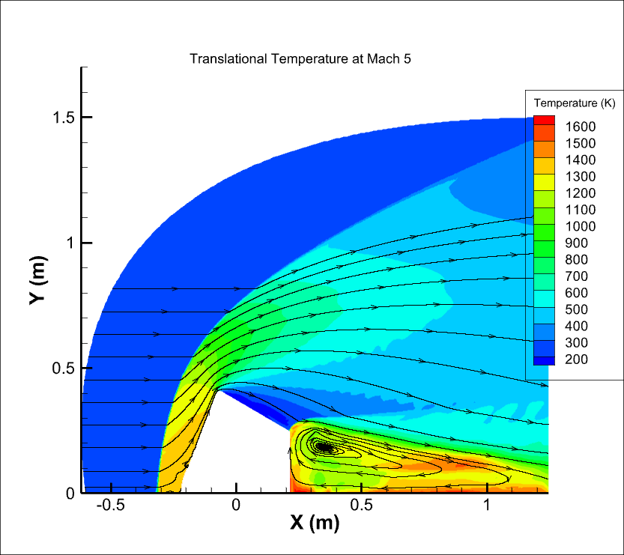
Results
Simulation
Plot shows translational temperature
Can see some vortices in wake region
Note shock structures
Temperature and Mach inversely related due to shocks
Notes:
12

Slide 10
Acknowledgements
I would like to thank Dr. Kyle Hanquist for being an extraordinary mentor through this project.
Special thanks to Dr. Ozgur Tumuklu for his support during this project.
This project would not have been possible without the NASA Space Grant Consortium.
Notes:
12

Slide 11

Thank You
Notes:
17

